Slide 1
BANK LOAN CASE STUDY

Slide 2
Project Description
This case study aims to identify patterns which indicate if a client has difficulty paying their installments which may be used for taking actions such as denying the loan, reducing the amount of loan, lending (to risky applicants) at a higher interest rate, etc. This will ensure that the consumers capable of repaying the loan are not rejected. Identification of such applicants using EDA is the aim of this case study. In other words, the company wants to understand the driving factors (or driver variables) behind loan default, i.e. the variables which are strong indicators of default. The company can utilize this knowledge for its portfolio and risk assessment.
Tech- Stack Used
Jupyter notebook – For cleaning, analyzing and visualizing data using python libraries such as NumPy, Pandas, Matplotlib and Seaborn

Slide 3
Data Cleaning
Application Data and previous application data
Checked columns for null values and removed columns having null values greater than 40% for application data and removed columns having null values greater than 30% for previous application data and the columns which are not necessary for analysis from both the datasets.
Imputing null values with suitable values (mean or median)
Binning certain columns into categorical columns which will be used for analysis.
Checked the datatype of variables and converted them into suitable datatypes.
Checked the dataset for duplicates and found that there are no duplicate values.

Slide 4
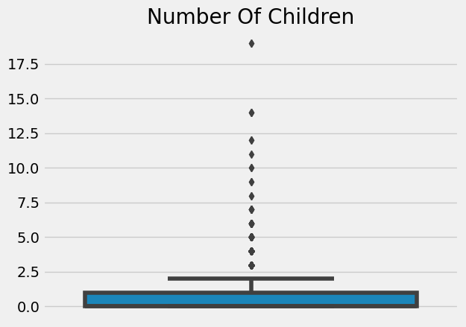
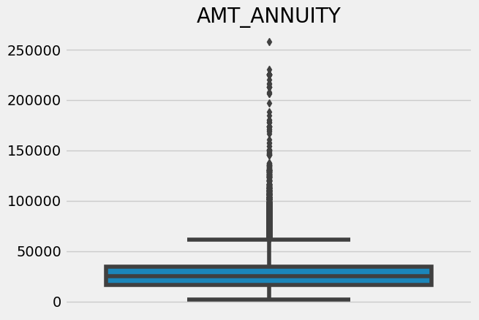
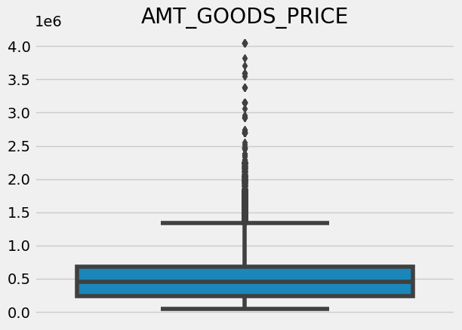
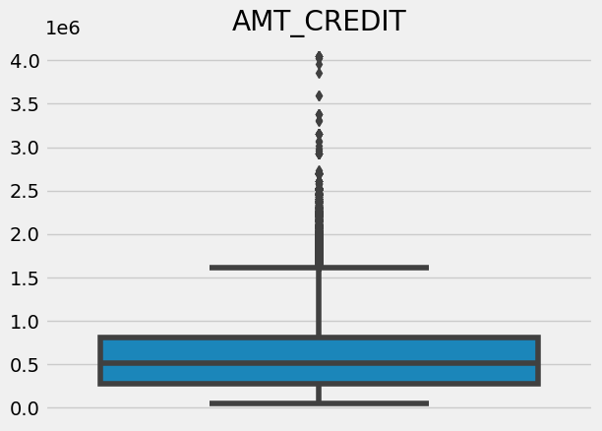
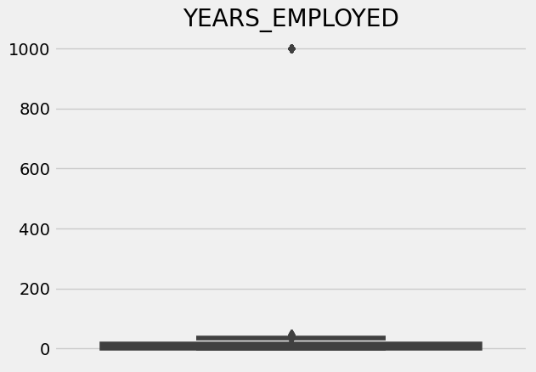
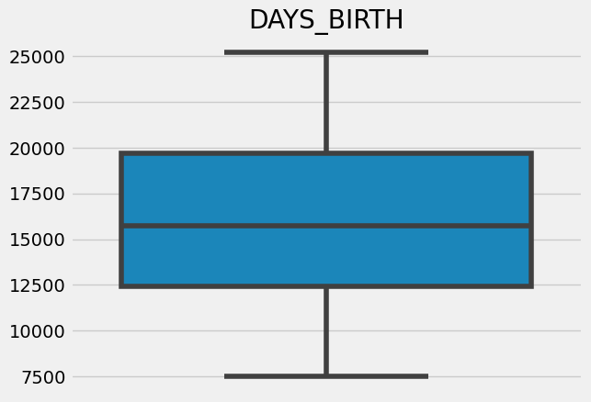
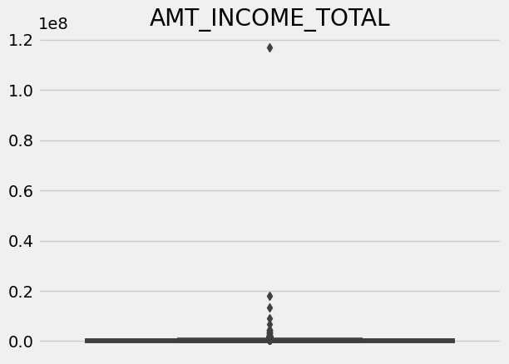
Identification Of Outliers
Application Data
By using both IQR method and by visualizing boxplots we can see that the columns 'AMT_ANNUITY','AMT_INCOME_TOTAL','AMT_CREDIT','AMT_GOODS_PRICE','YEARS_EMPLOYED','CNT_CHILDREN' have outliers.
We can see that the maximum outlier value for the column CNT_CHILDREN is 19 which is highly unlikely, and the maximum outlier value for YEARS_EMPLOYED is 1000 which is not possible.
The column DAYS_BIRTH does not have any outliers.

Slide 5
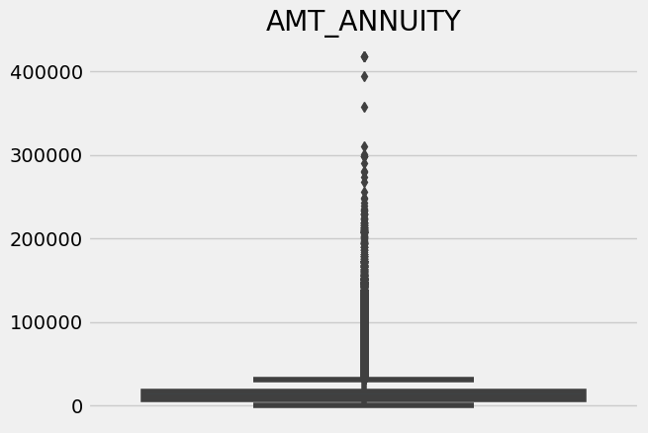
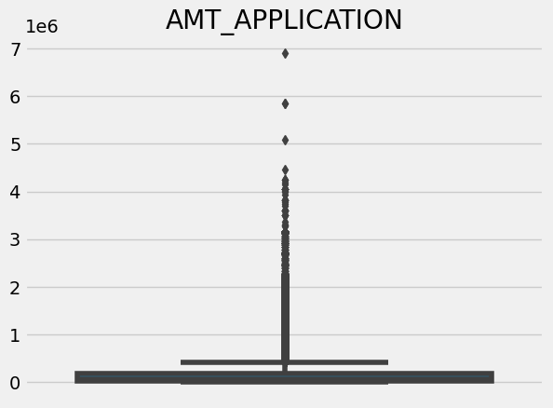
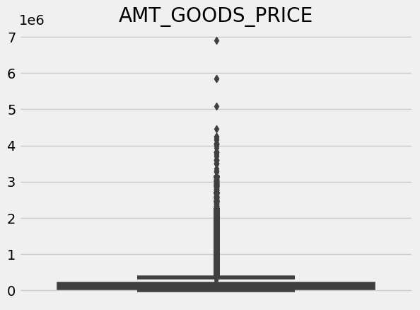
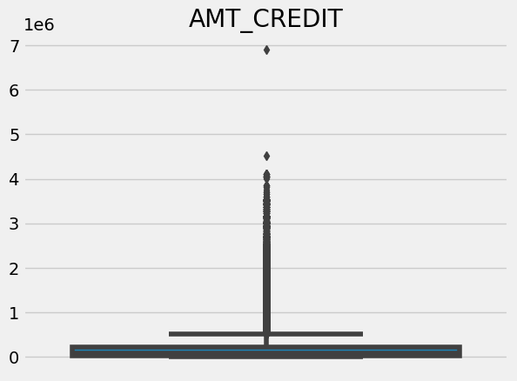
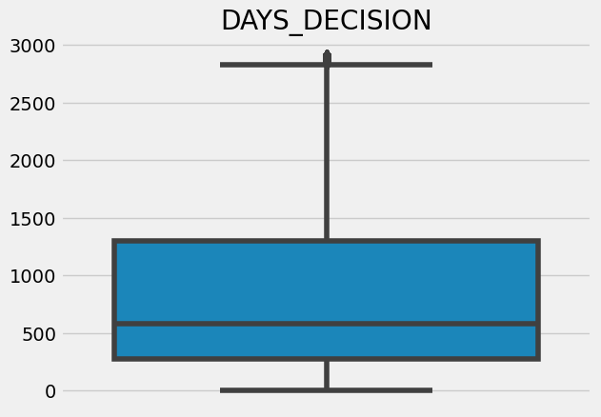
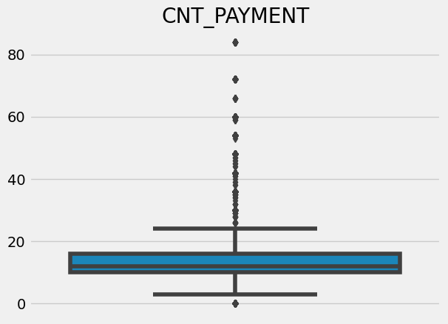
Identification Of Outliers
Previous application data
By using both IQR method and by visualizing boxplots we can see that the columns 'AMT_ANNUITY','AMT_APPLICATION','AMT_CREDIT','AMT_GOODS_PRICE','DAYS_DECISION','CNT_PAYMENT' have outliers.

Slide 6
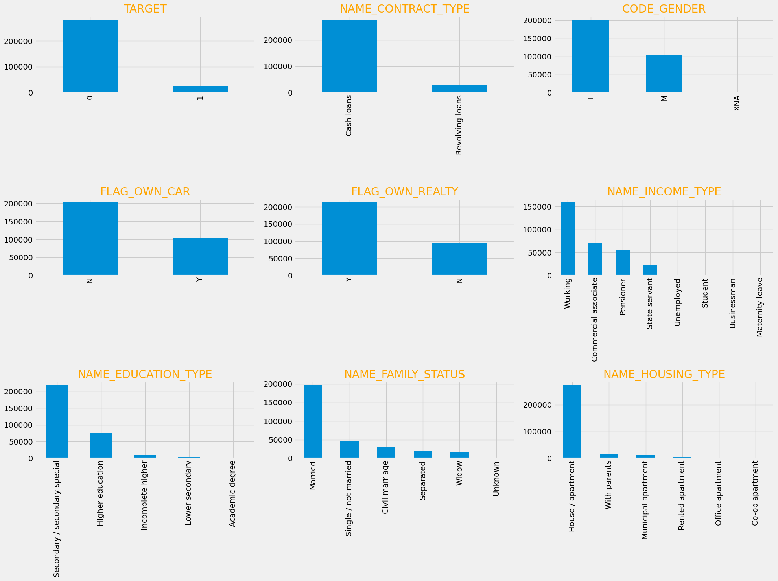
Data Imbalance
Application Data:
The data has huge imbalance with regards to the TARGET variable. We have extensive data for applicants who are likely to repay the loan but relatively very less data for applicants likely to have difficulty in repayment.
There is also data imbalance in the NAME_CONTRACT_TYPE variable. There is more data for Cash loans than Revolving loans.
In NAME_FAMILY_STATUS there are many data for married people and in NAME_HOUSING_TYPE most of the applicants live in House/Apartments

Slide 7
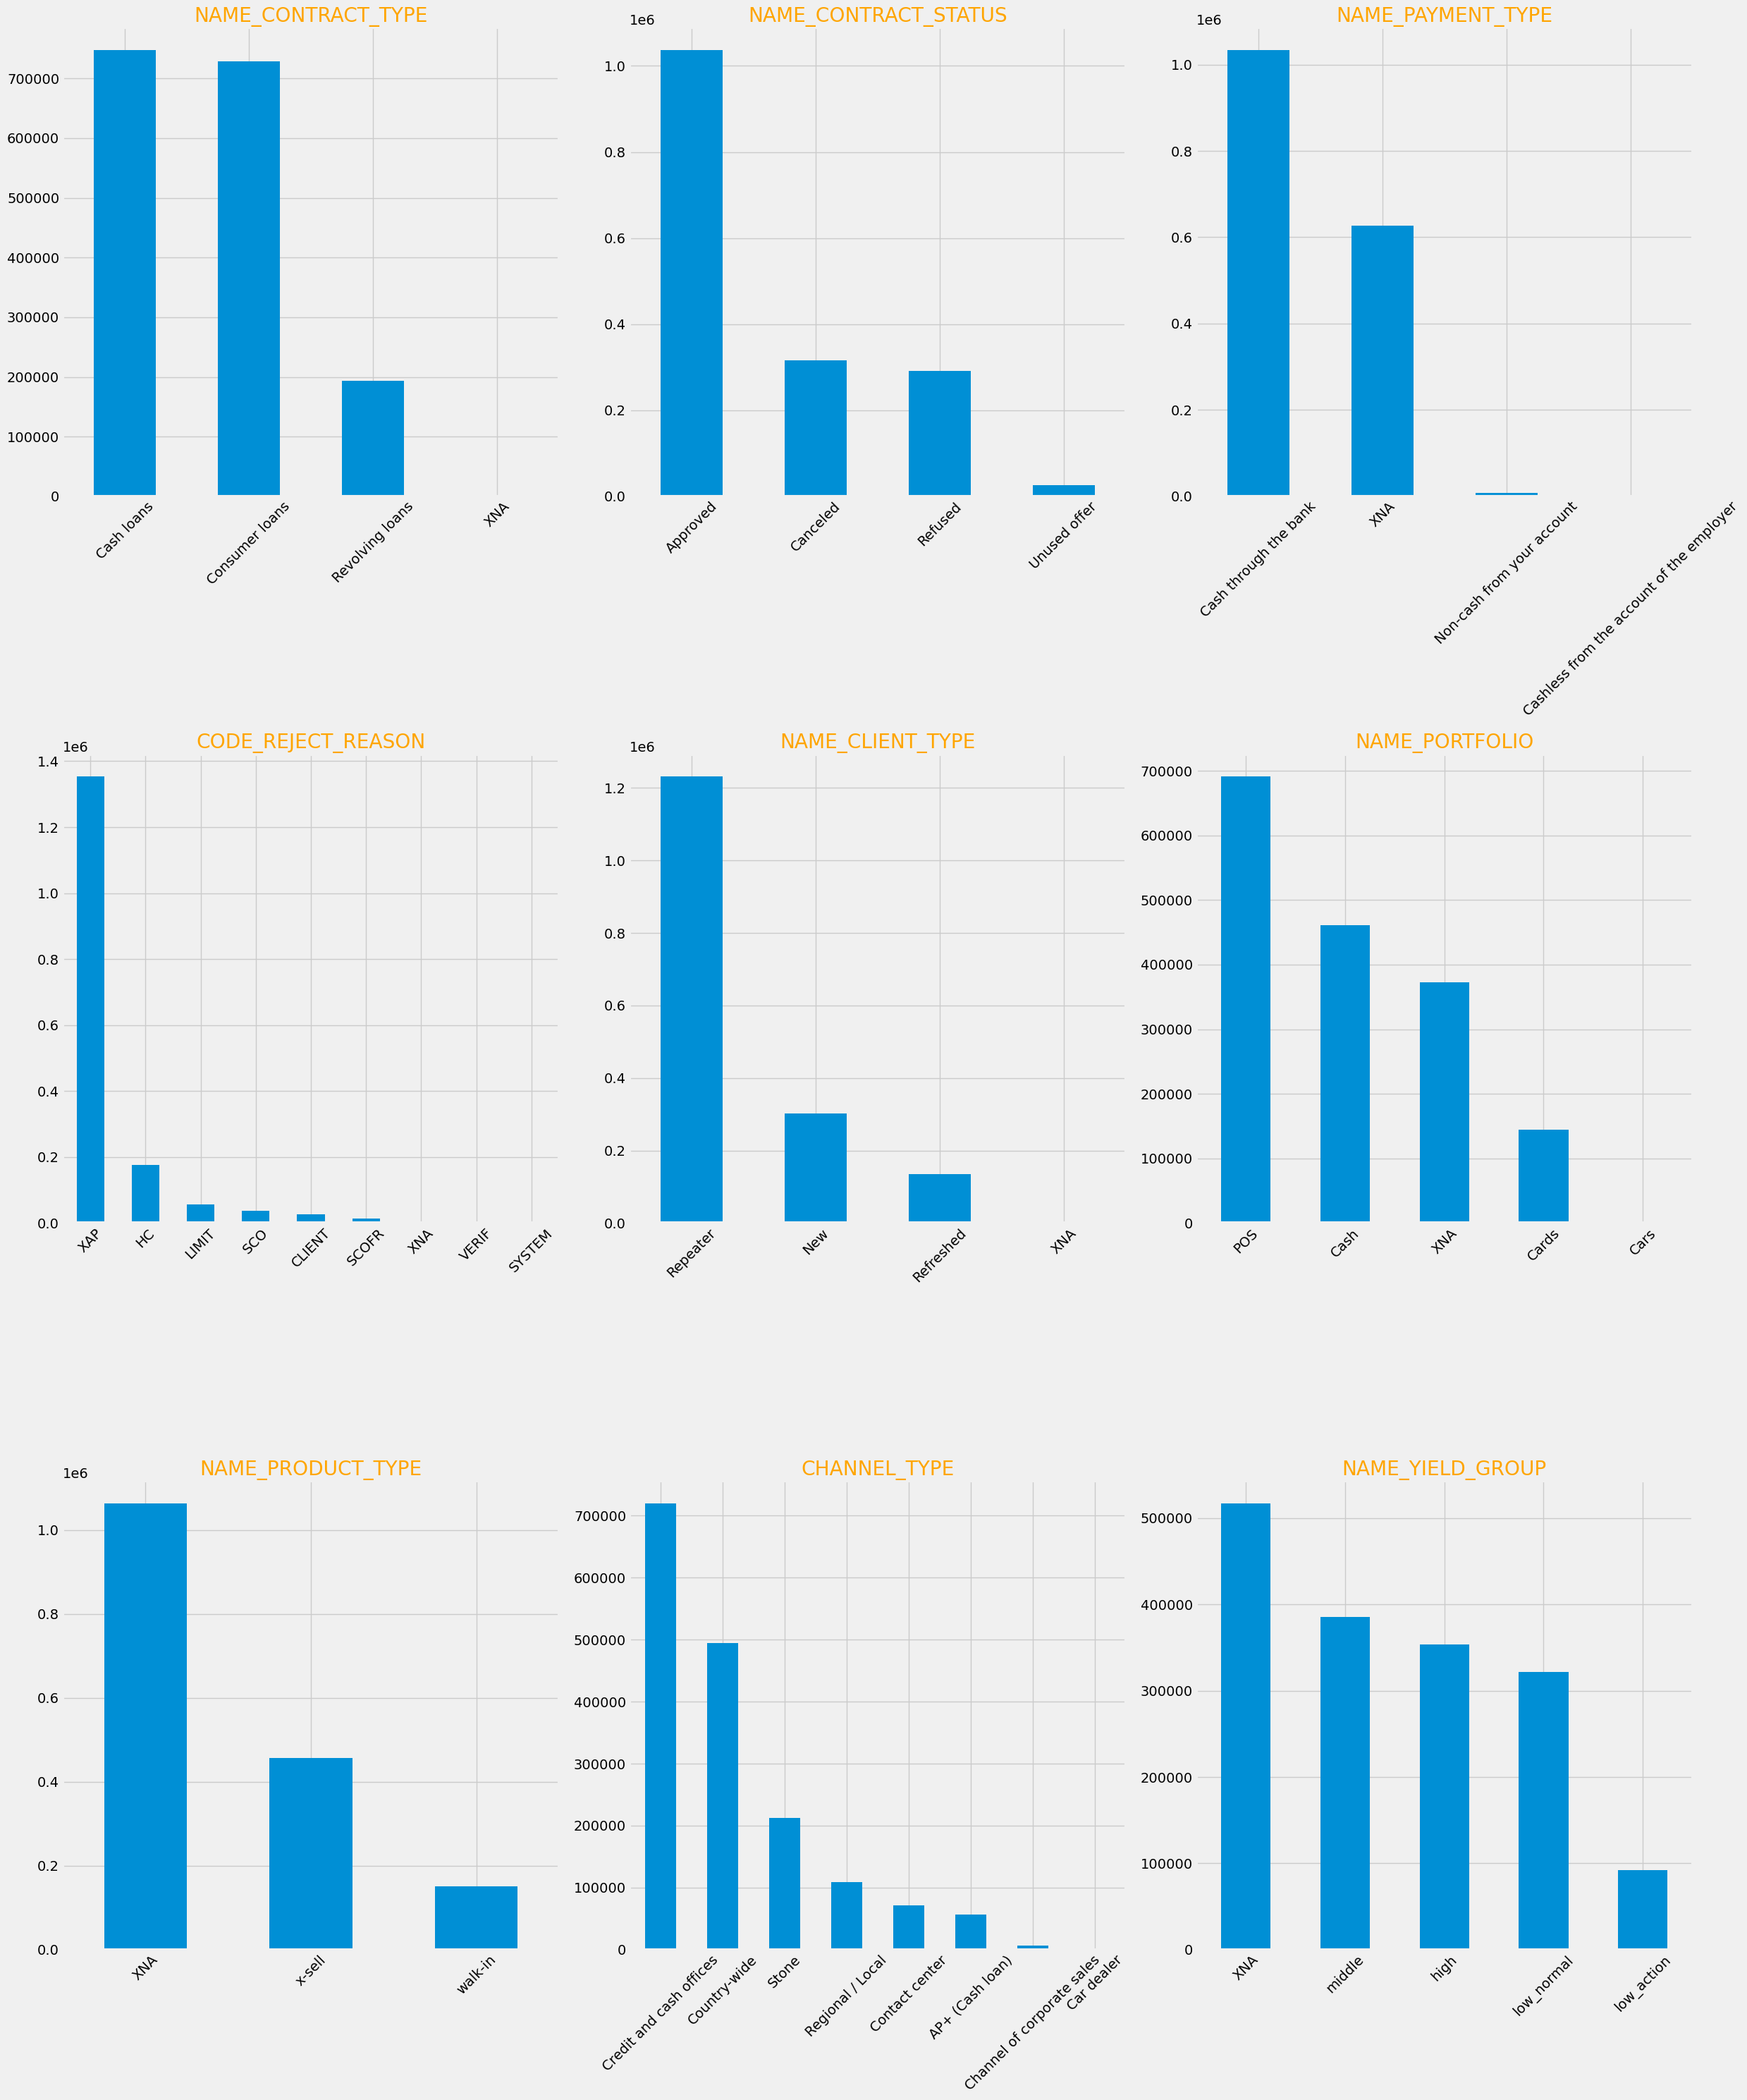
Data Imbalance
Previous Application Data
Most of the data is for Cash loans and consumer loans. There are few records for revolving loans.
There are very few records for unused offer, few data for refused and cancelled loans and huge amount of data for approved loans.
There are a large number of repeater applicants than refreshed and new applicants.
There are large number of data for payment type cash through banks than other payment modes.
There are large number of data for credit and cash offices, followed by country-wide and stone than other channel type.
There are large number of data for POS and almost no data for cars.

Slide 8
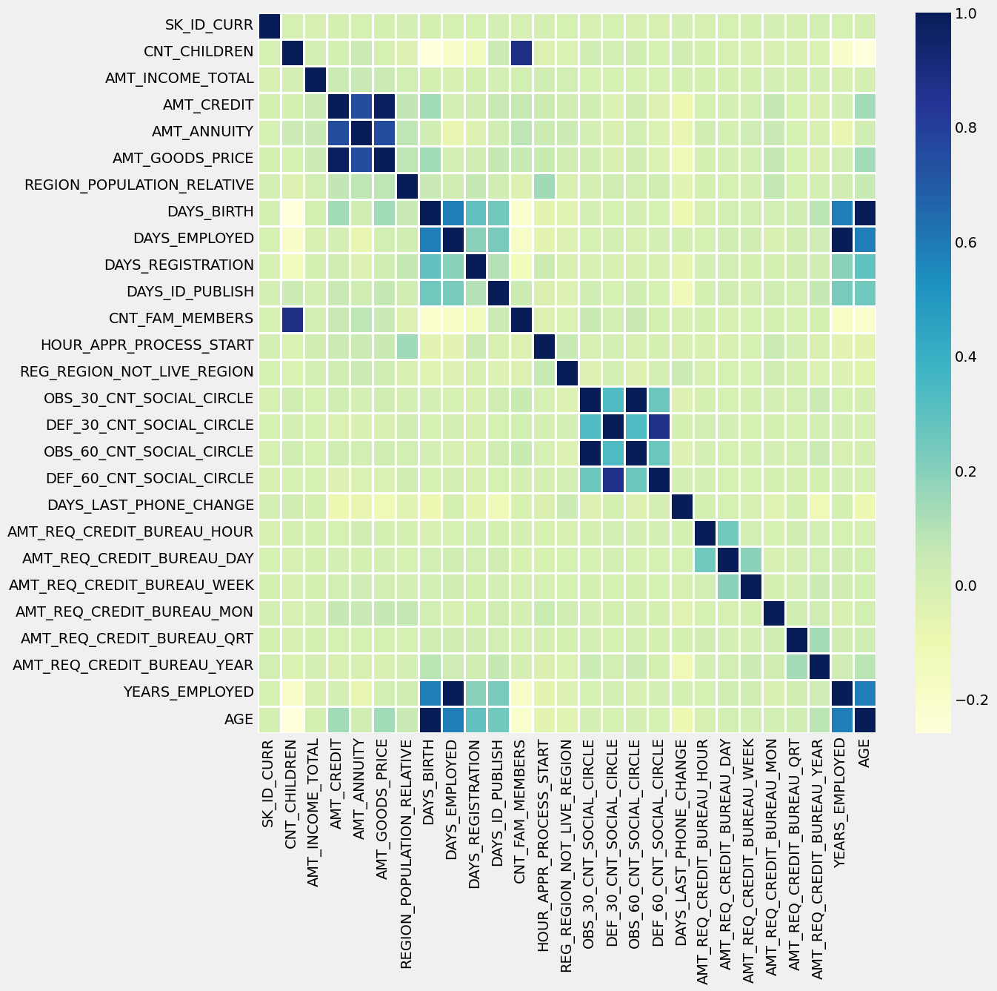
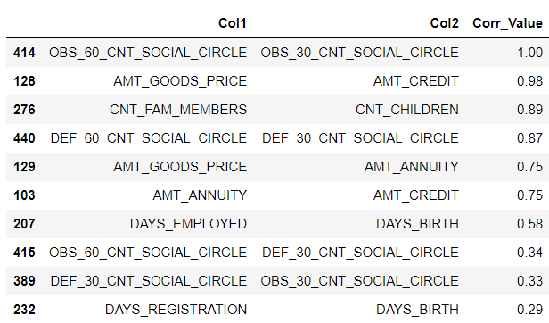
Correlation
Top 10 correlation variables for defaulters : Application data

Slide 9
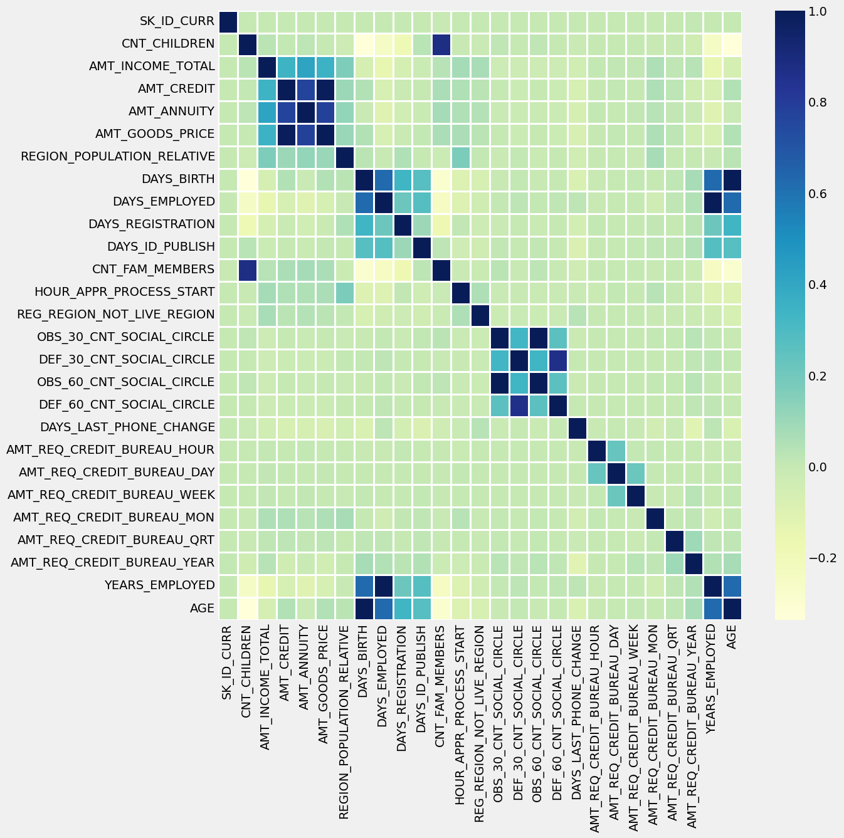
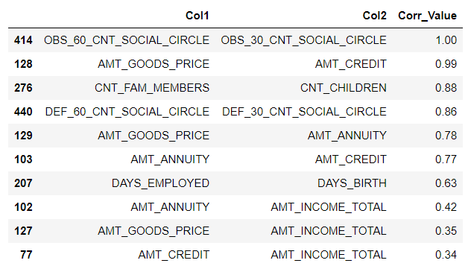
Correlation
Top 10 correlation variables for non defaulters: Application data

Slide 10
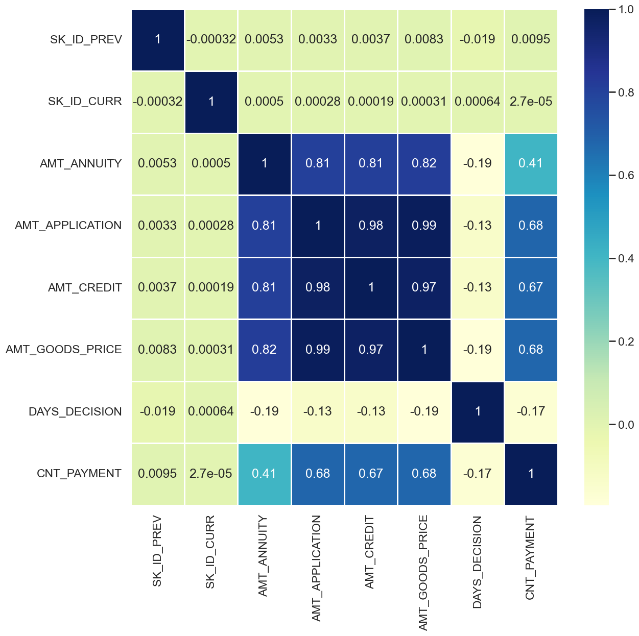
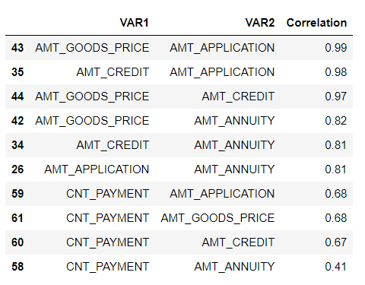
Correlation
Top 10 correlation variables – Previous Application data :

Slide 11
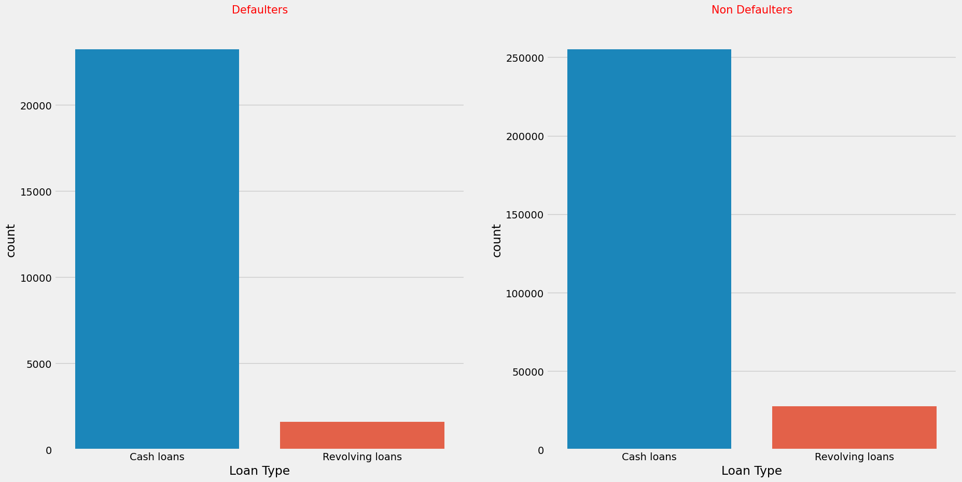
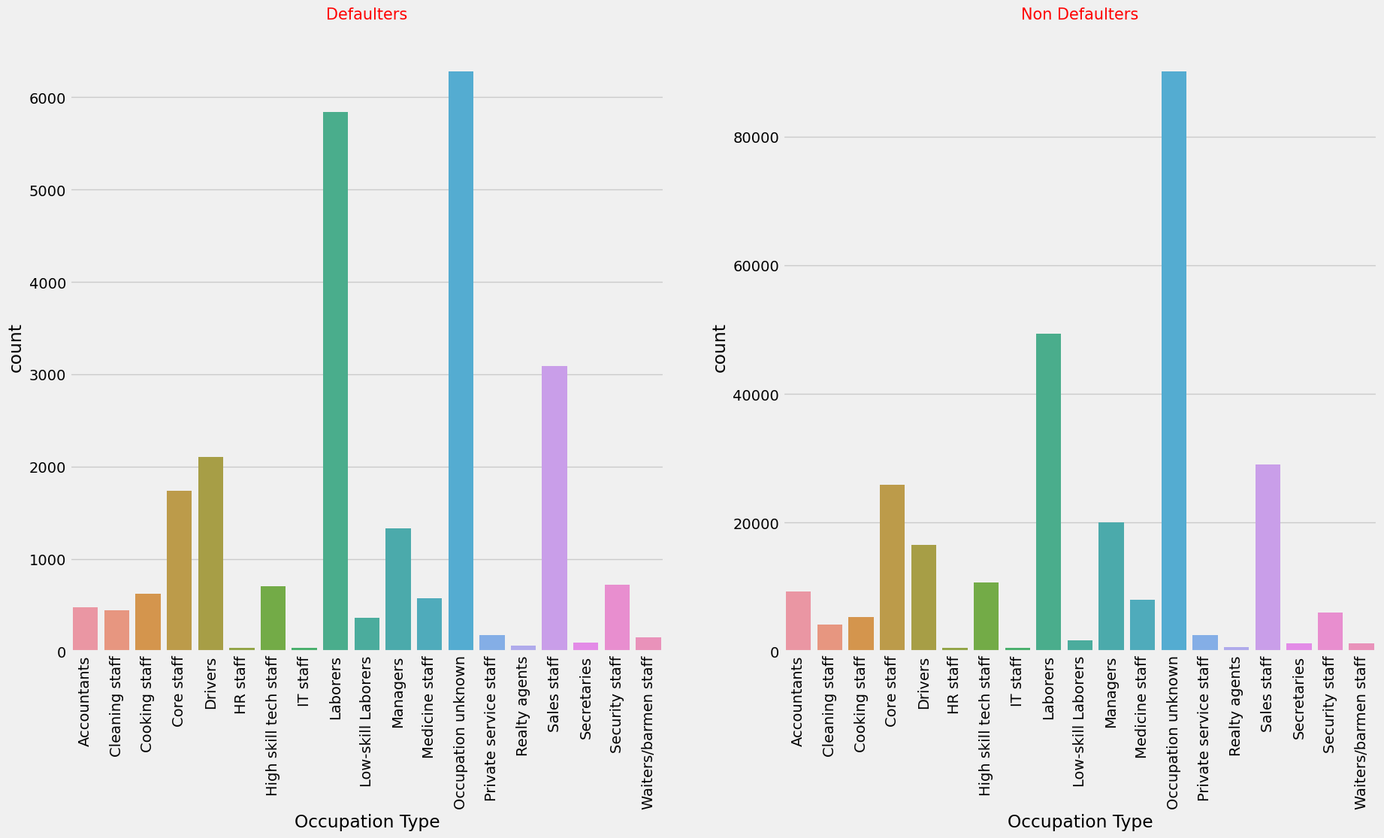
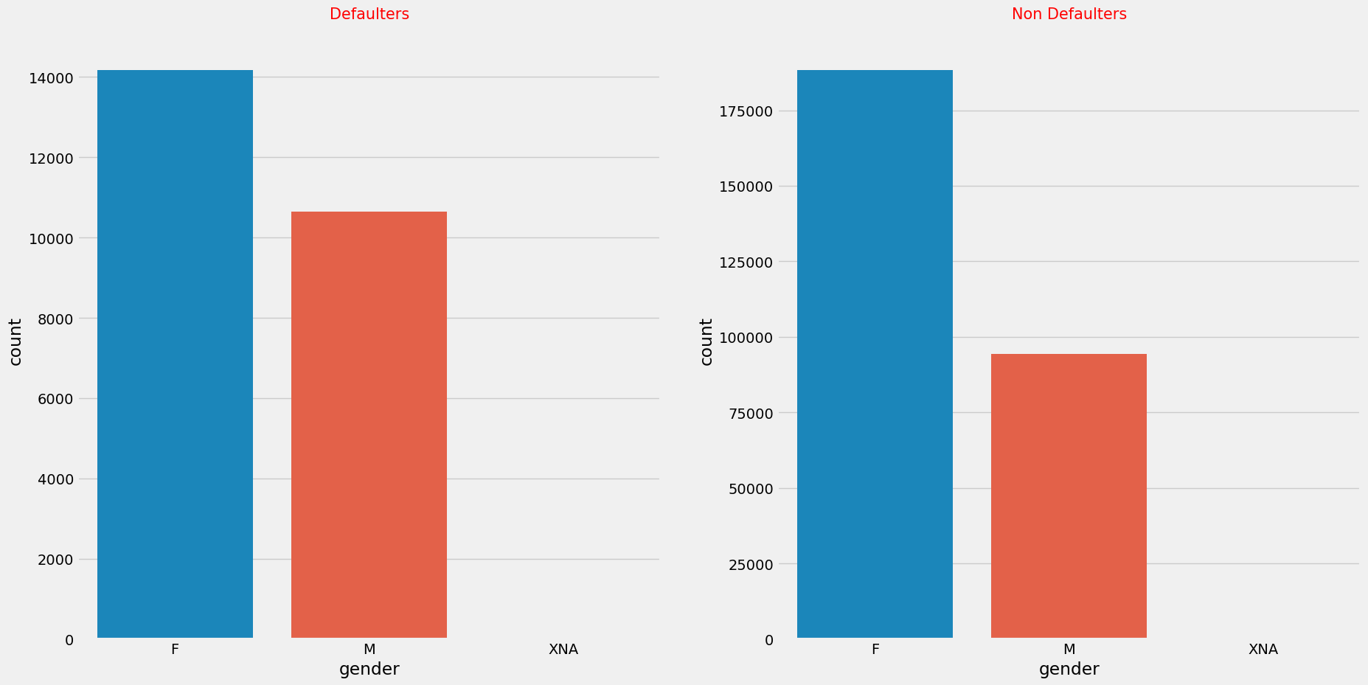
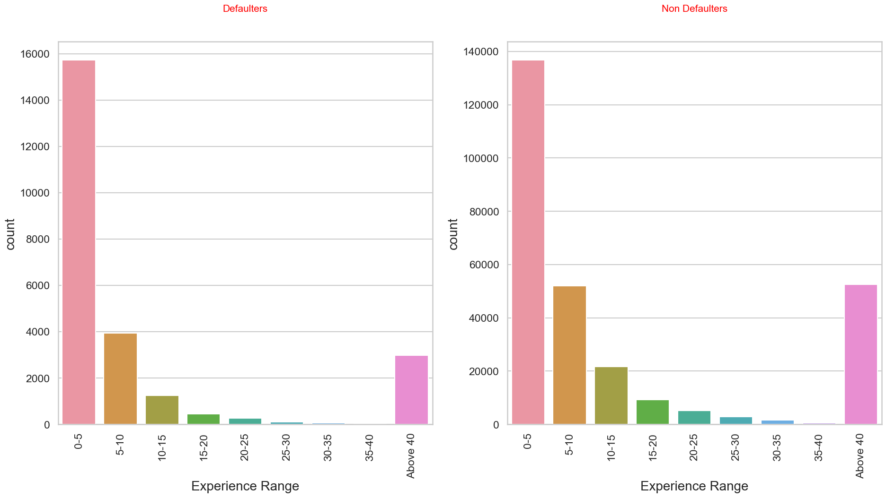
Univariate Analysis On Categorical Columns
The number of female applicants is greater than male applicants in both defaulters and non defaulters list.
Both cases seem to follow the same pattern where Cash loans is greater than Revolving loans.
In both defaulters and Non defaulters the occupation is unknown for a huge percentage of applicants.
For the applicants who have mentioned their occupation, we find that Laborers are most likely to default followed by Sales staff.
Applicants who have less work experience in the range 0-5 years default more than applicants with more experience.

Slide 12
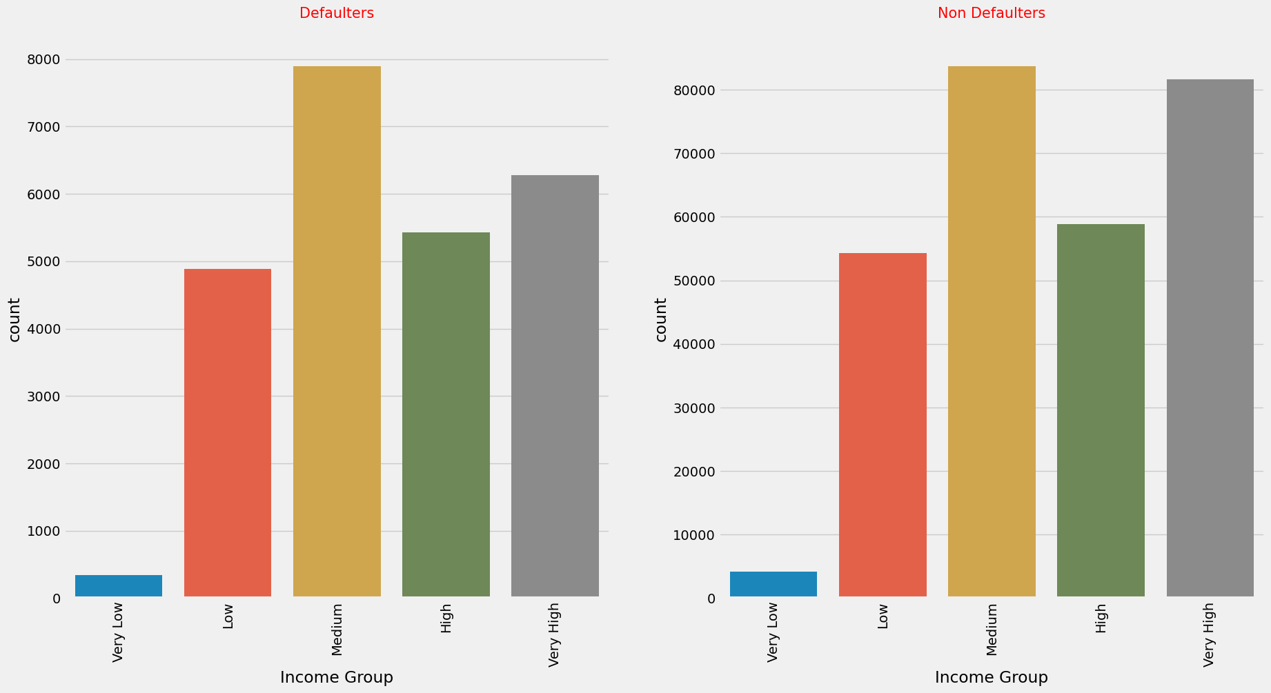
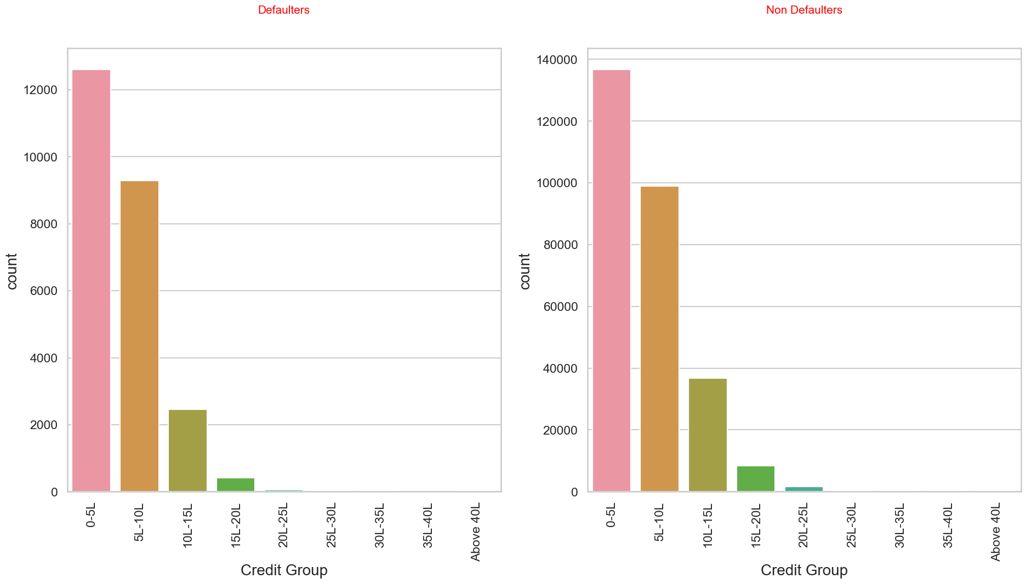
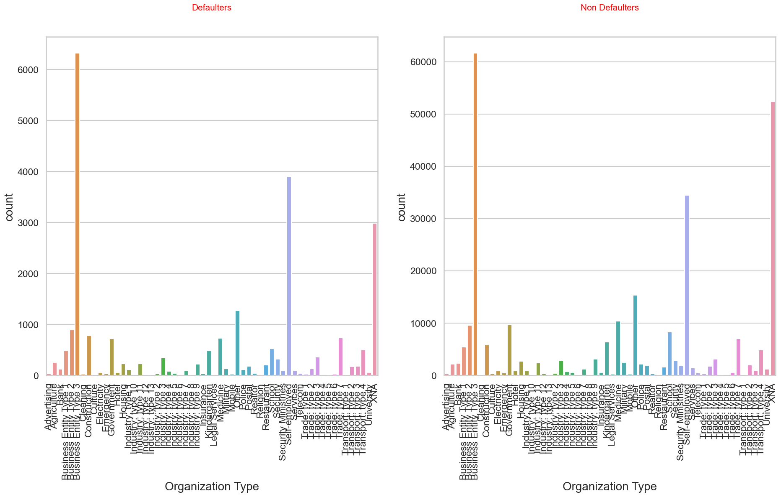
We find that applicants in the Medium income group are the most to default than the applicants with very low income.
Applicants with credit amount 0-5 lakhs are the most to default.
We find that applicants who are most likely to default are those who work in Business_Entity_Type 3 follwed by those who are self-employed.

Slide 13
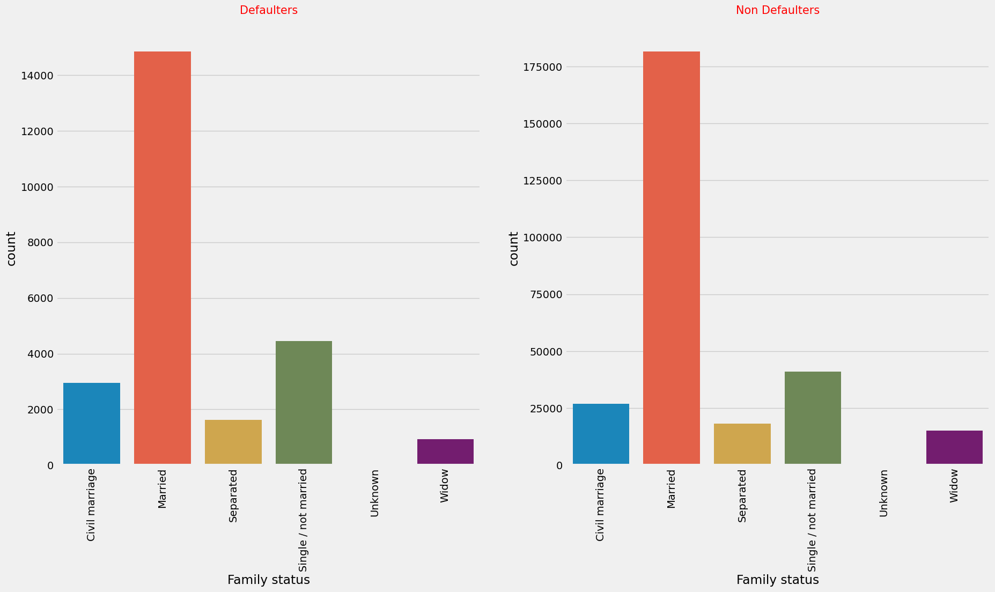
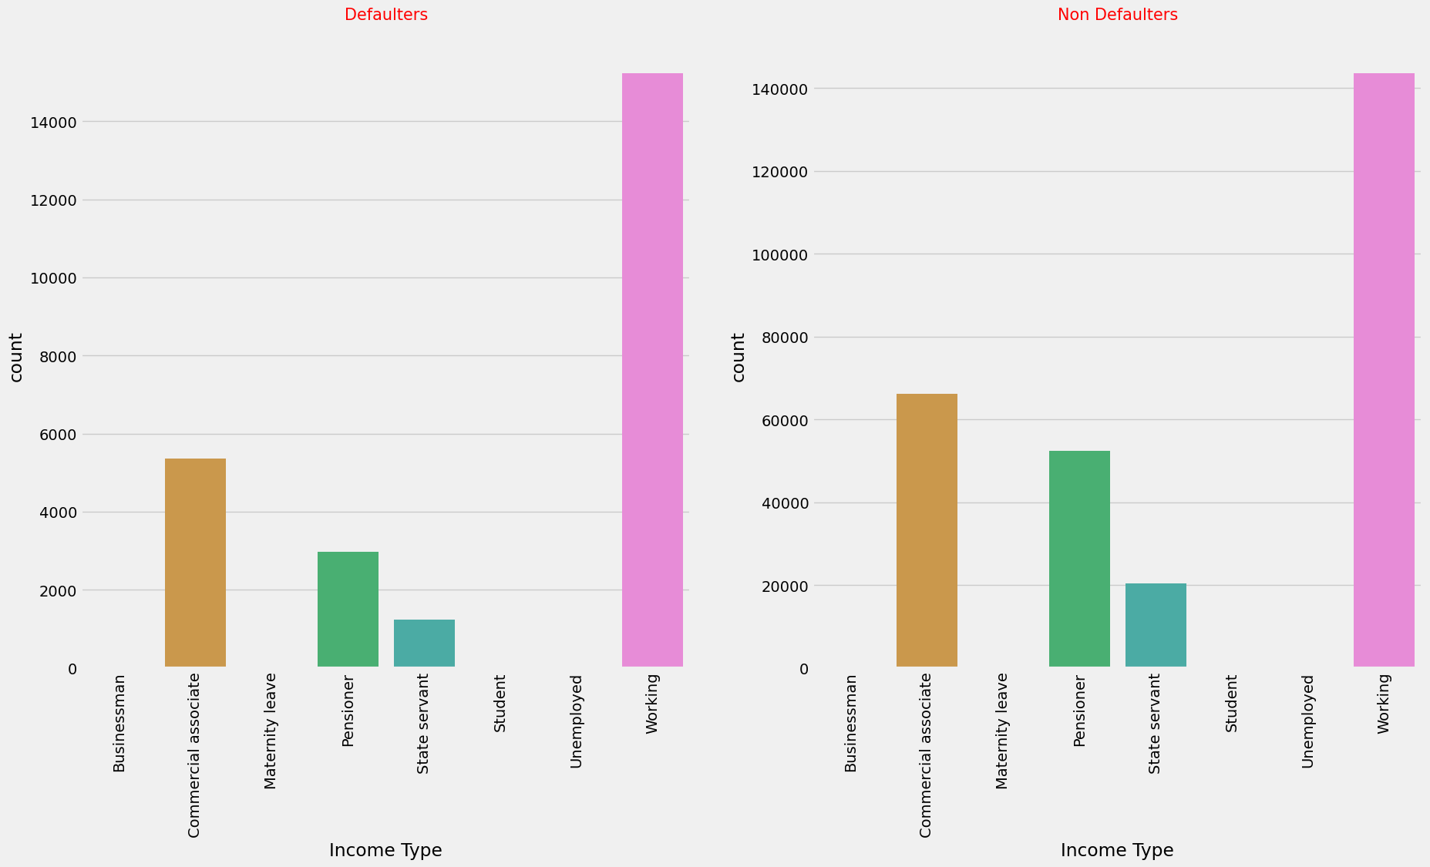
Both cases seem to follow the same pattern where most applicants are married.
Both cases seem to follow the same pattern where most applicants who are working have higher count in both defaulters and repayers list.

Slide 14
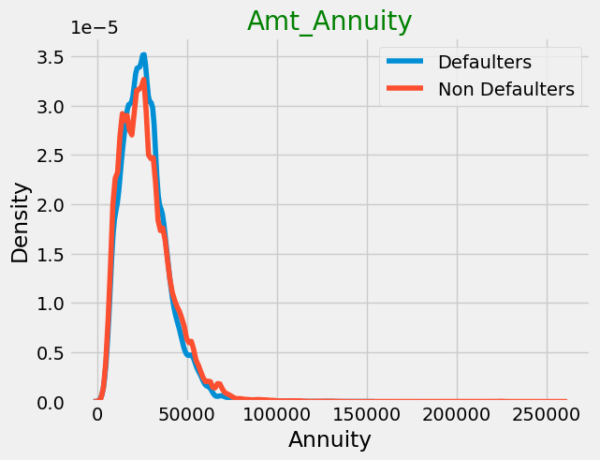
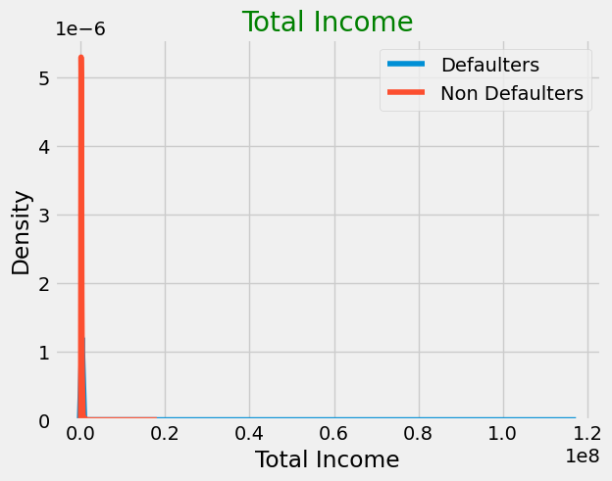
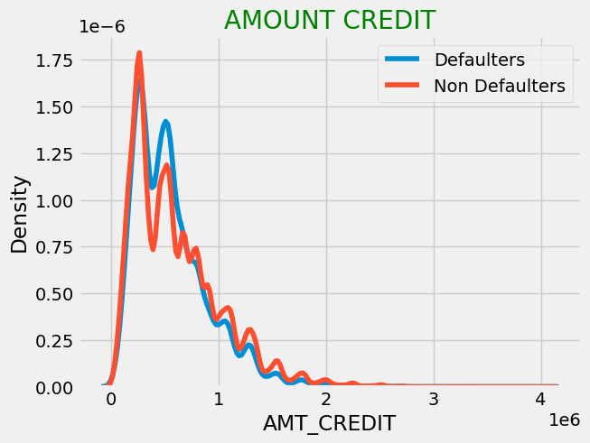
Univariate Analysis on numerical variables
Majority of applicants annuity amount is below 50000
We can see that the value for defaulters reach its peak with lesser credit amount.
Most of the applicants are in the low income range.

Slide 15
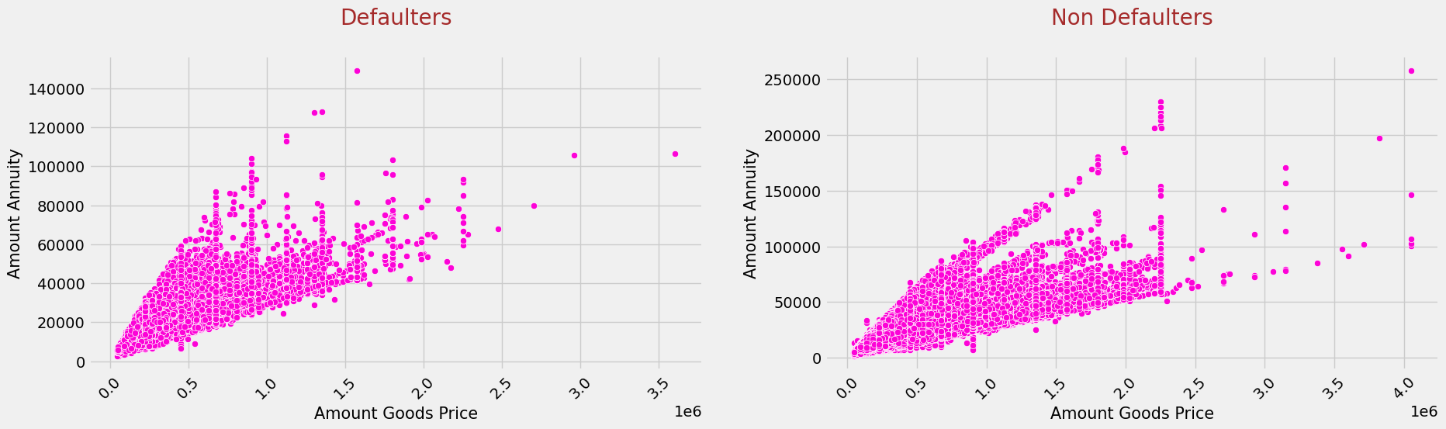
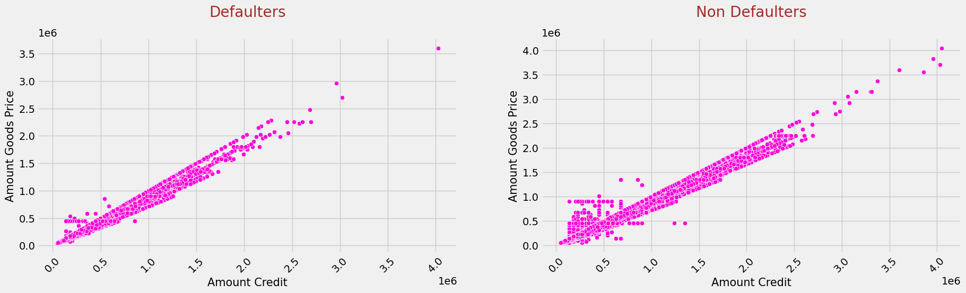
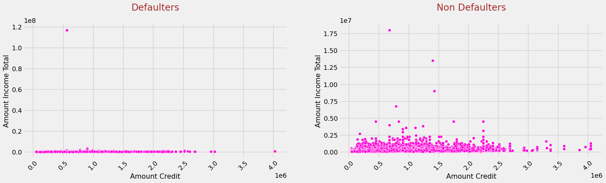
Bivariate Analysis
Higher the price of the goods, higher will be the loan amount. Therefore AMT_CREDIT and AMT_GOODS_PRICE are positively correlated.
Higher the loan amount credited, higher will be the annuity. Therefore AMT_CREDIT and AMT_ANNUITY are positively correlated.
As we saw before as the price of the goods increases, the loan amount increases which results in increased annuity. Also from the plot we can see that AMT_GOODS_PRICE and AMT_ANNUITY are correlated.
From the plot we can see that AMT_CREDIT and AMT_INCOME_TOTAL are not correlated.

Slide 16
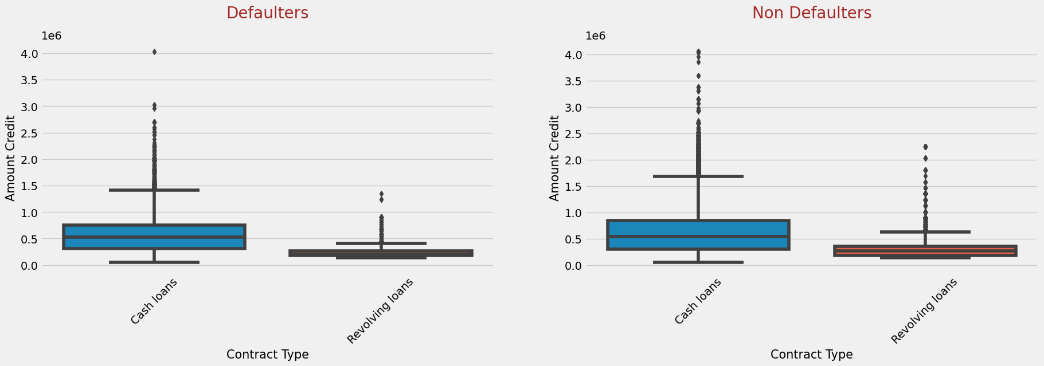
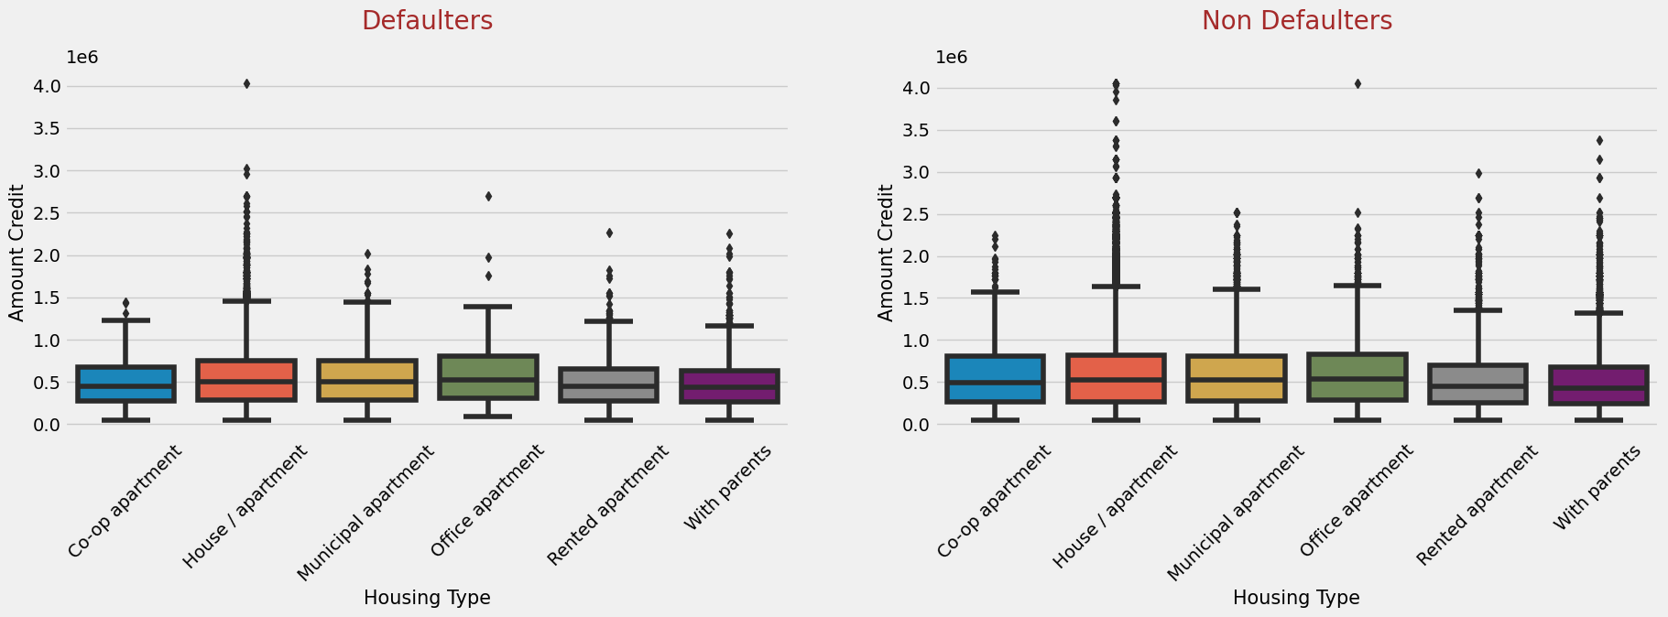
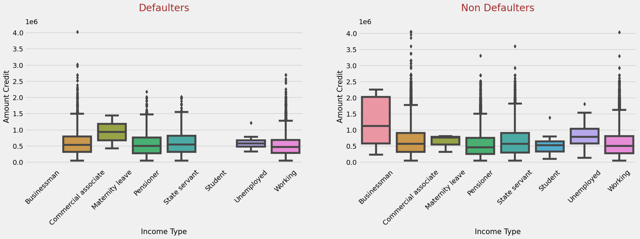
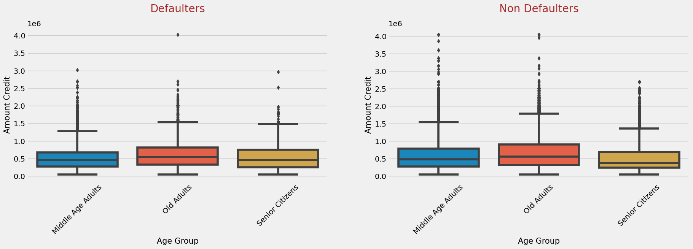
Cash loans have higher amount credited when compared to revolving loans.
Businessman have taken higher loan amounts and they do not seem to default the loan along with students.
Loan amount credited is slightly higher for applicants living in House/apartment.
We see that middle age adults are probably the least likely to default.

Slide 17
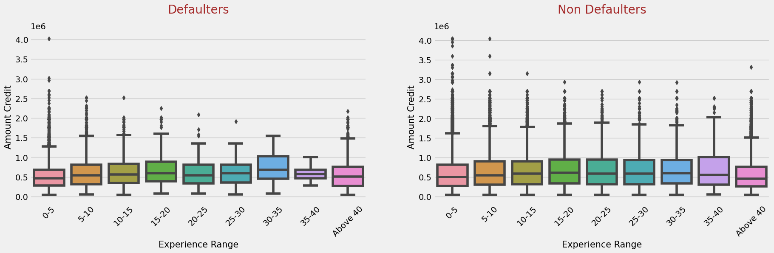
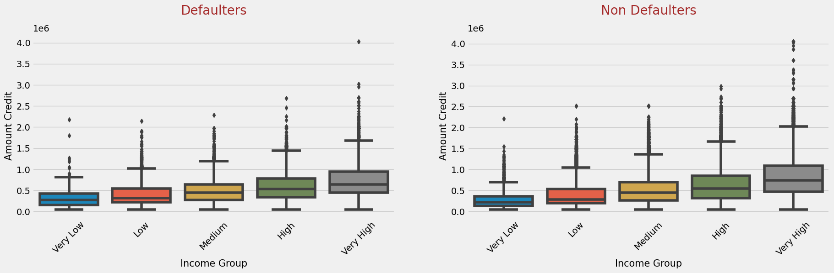
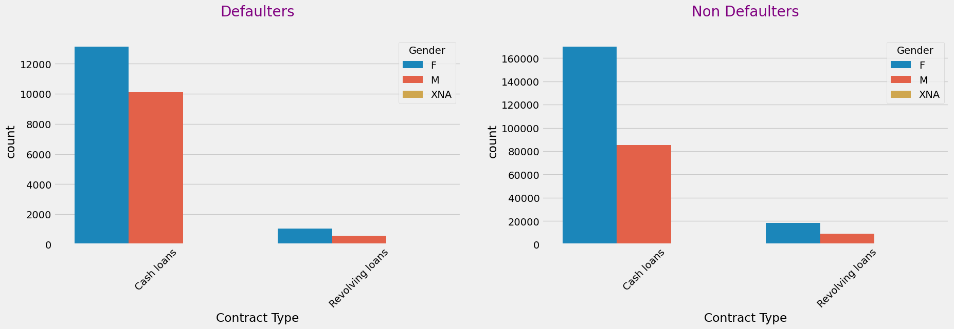
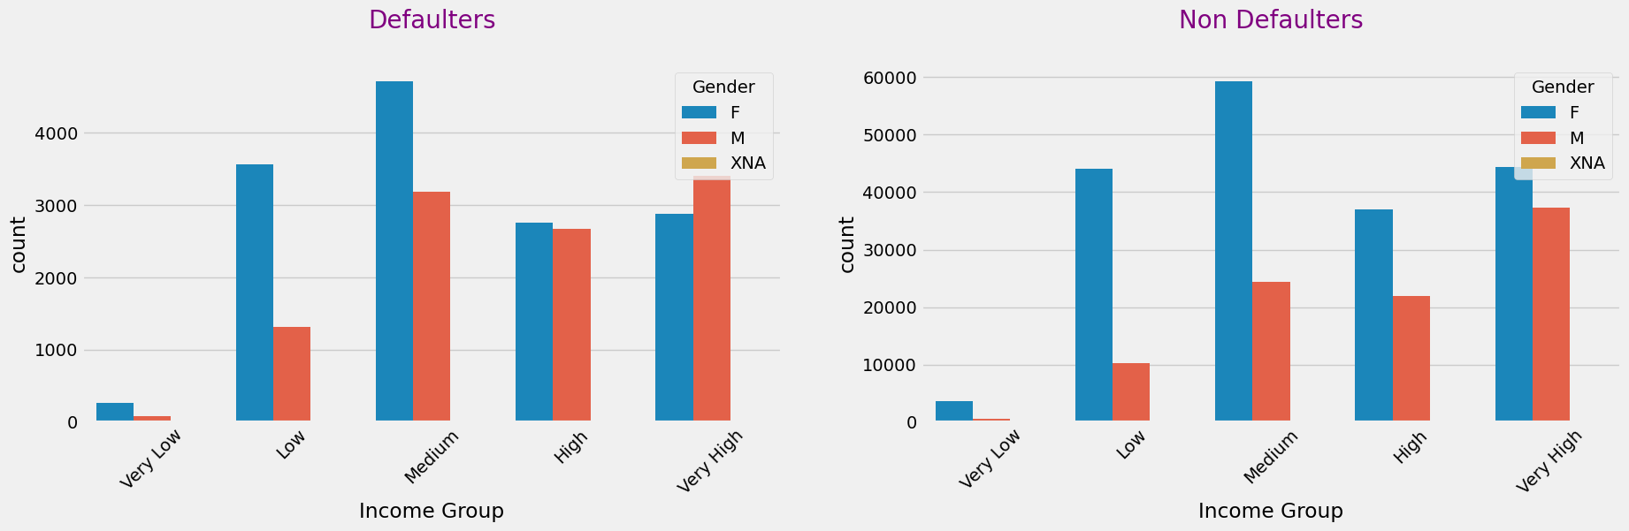
Applicants with higher work experience are credited higher loan amount.
We can see that applicants belonging to very high income group are able to repay the loan.
Majority of the applicants are female and have taken cash loans.
Male applicants with very high income have defaulted more than female.

Slide 18
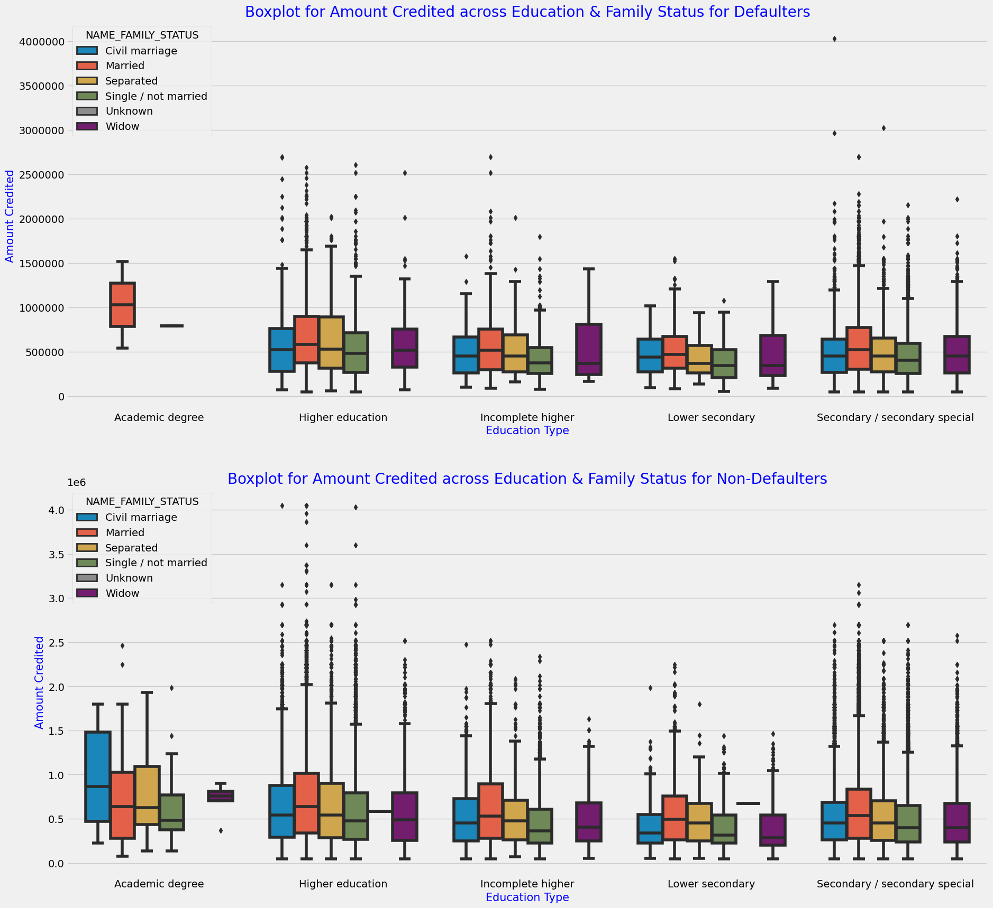
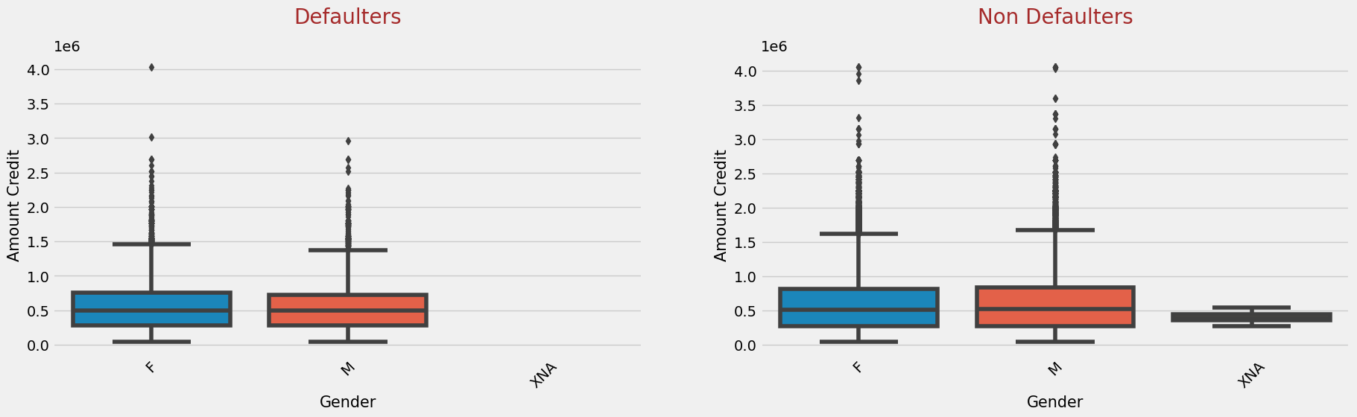
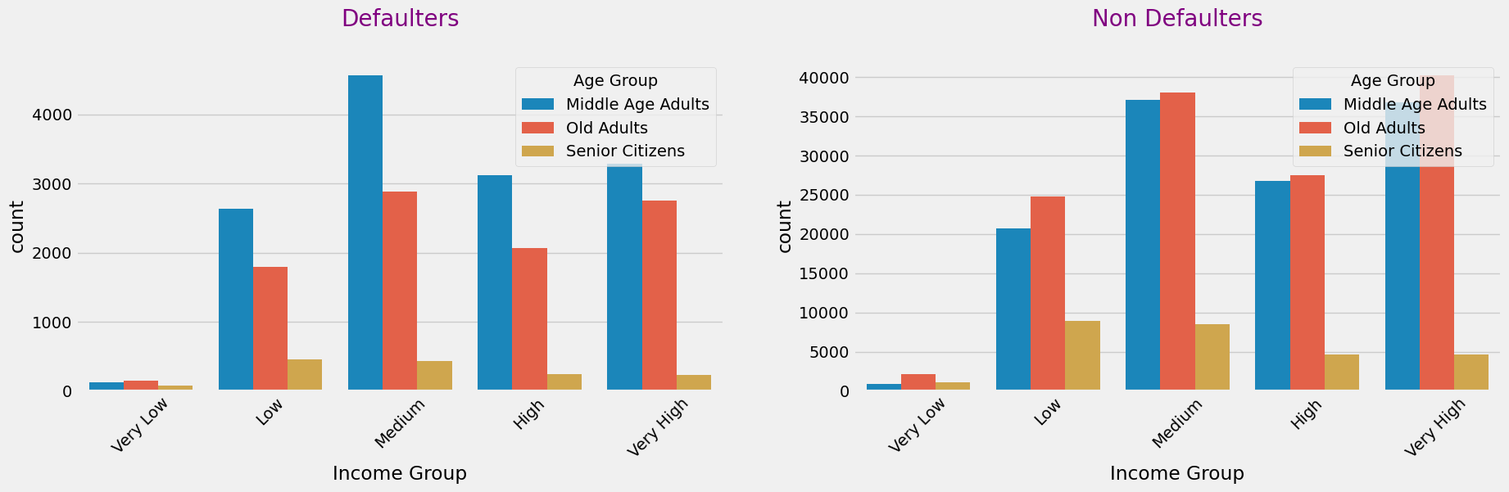
Middle age adults belonging to medium income group have defaulted more.
It can be seen that most of the applicants are married irrespective of their education and the loan amount credited seems to be higher for people with higher education followed by people with academic degree.
There isn’t much difference in the amount credited for male and female applicants.

Slide 19
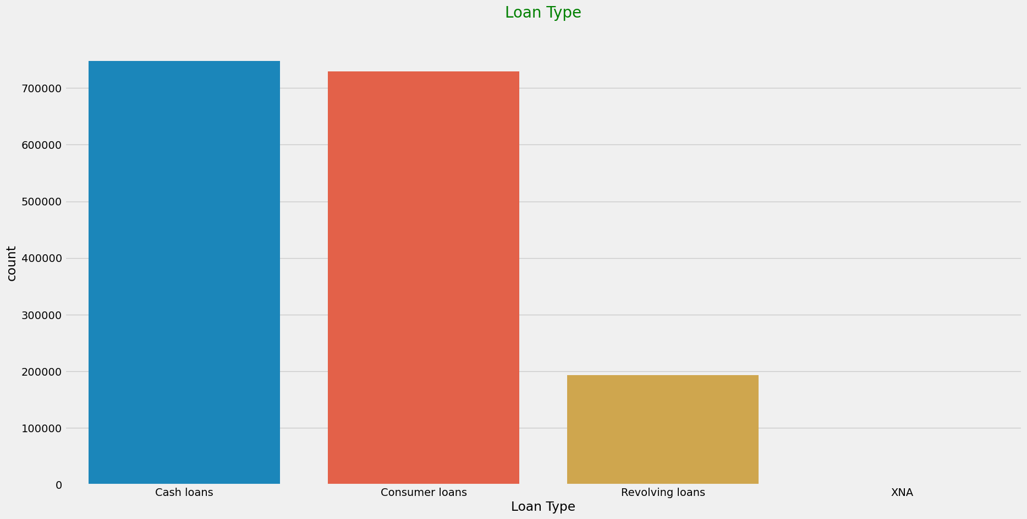
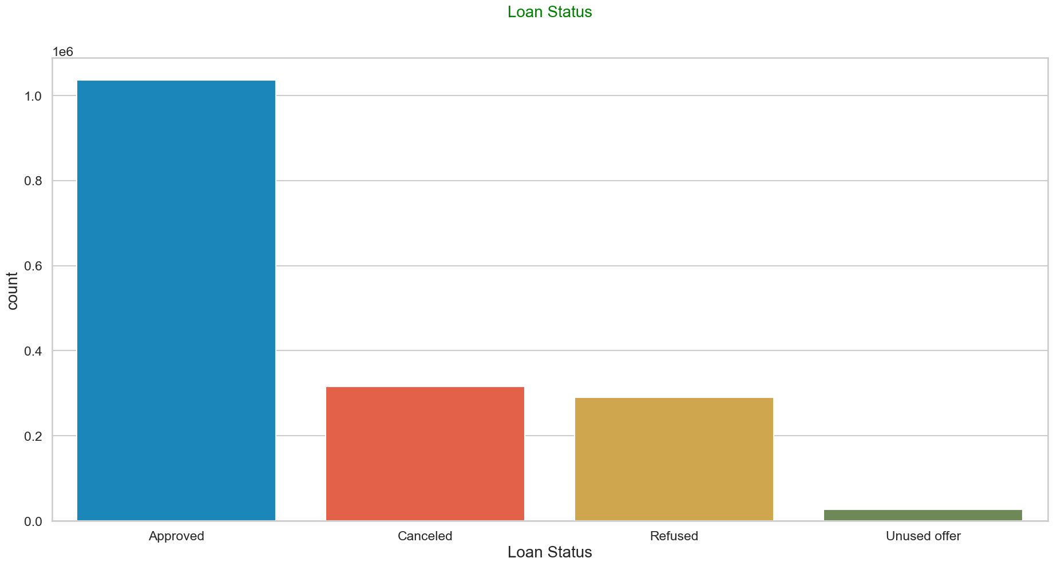
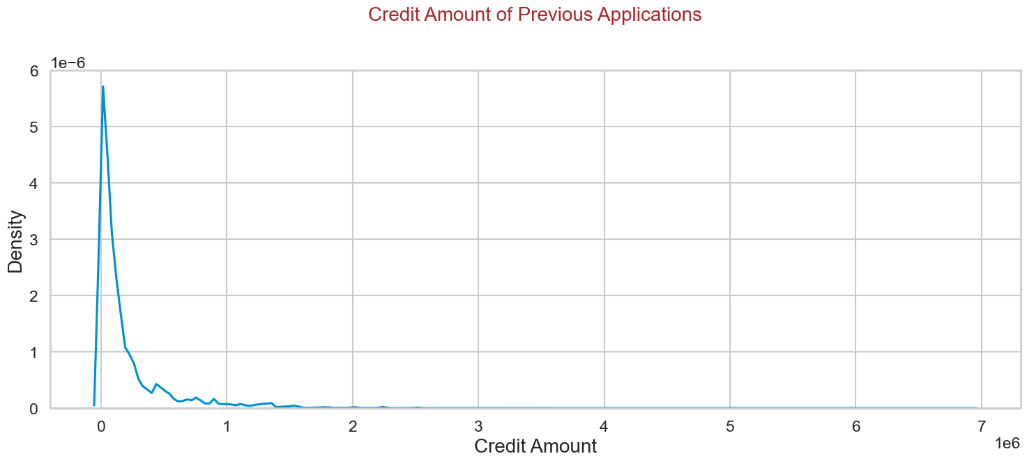
Previous Application data
Univariate Analysis:
Majority of the previous loans are either cash loans or consumer loans.
Majority of the loan applications were approved.
Most of the previous loans have low credit amount

Slide 20


Consumer loans have the highest approval rate followed by cash loans and then revolving loans.
Majority of the loans which were refused are cash loans.
Majority of the applications which were approved are from repeating applicants, followed by new applicants.

Slide 21

Merged Data
Analyzing NAME_CASH_LOAN_PURPOSE and NAME_CONTRACT_STATUS w.r.t TARGET:
Loan purpose has high number of unknown values (XAP, XNA)
Loan taken for the purpose of 'Repairs' and 'other' seems to have highest refusal rate

Slide 22


The bank has approved the applications of customers under the category of middle age adults and old adults more than senior citizens and they also seem to default more than senior citizens.
Applicants with high income and unused offers are more likely to default compared to others.

Slide 23
Recommendation/Conclusion
Banks must consider the education of the applicants as customers with higher education and academic degree have less defaults.
Banks should focus more on 'Businessman' and 'Students' as they have low default rate and avoid 'Laborers' as they have high default rate.
Since customers taking cash loans for repairs and urgent needs are more likely to default, bank can refuse them.
Banks must also look into applicants work experience as those who have less work experience in the range 0-5 years default more than applicants with more experience.

